Slide 1
Why Math?
Yuliya Gorb
Program Director
Division of Mathematical Sciences, NSF

Slide 2
Outline
Importance to learn MATH
Why go to University?
Why study Math in University?
Careers in MATH
Differences between Pure and Applied Math

Slide 3
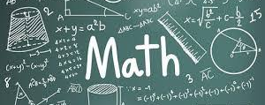
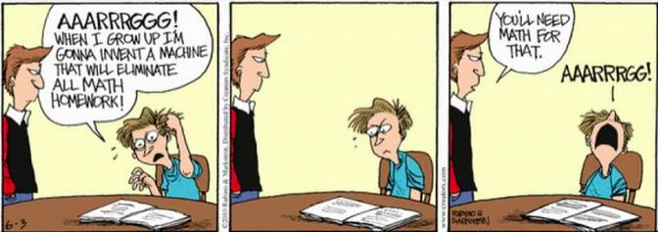
Why Study Math?
Useful
Important
Interesting
Mathematics is

Slide 4
Why go to a University?

Slide 5
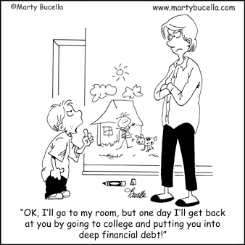
Why to go to a University?
Increase your earning potential
Gain job security
Get health insurance
Learn a valuable skill
Create and maintain networking
Become more financially fit
Expand your career options
Broaden your horizons

Slide 6
Why to go to a University?
Increase your earning potential
Gain job security
Get health insurance
Learn a valuable skill
Create and maintain networking
Become more financially fit
Expand your career options
Broaden your horizons

Slide 7
Why to go to a University?
Increase your earning potential
Gain job security
Get health insurance
Learn a valuable skill
Create and maintain networking
Become more financially fit
Expand your career options
Broaden your horizons

Slide 8
Why to go to a University?
Increase your earning potential
Gain job security
Get health insurance
Learn a valuable skill
Create and maintain networking
Become more financially fit
Expand your career options
Broaden your horizons

Slide 9
Why to go to a University?
Increase your earning potential
Gain job security
Get health insurance
Learn a valuable skill
Create and maintain networking
Become more financially fit
Expand your career options
Broaden your horizons

Slide 10
Why to go to a University?
Increase your earning potential
Gain job security
Get health insurance
Learn a valuable skill
Create and maintain networking
Become more financially fit
Expand your career options
Broaden your horizons

Slide 11
Why to go to a University?
Increase your earning potential
Gain job security
Get health insurance
Learn a valuable skill
Create and maintain networking
Become more financially fit
Expand your career options
Broaden your horizons

Slide 12
Why to go to a University?
Increase your earning potential
Gain job security
Get health insurance
Learn a valuable skill
Create and maintain networking
Become more financially fit
Expand your career options
Broaden your horizons

Slide 13
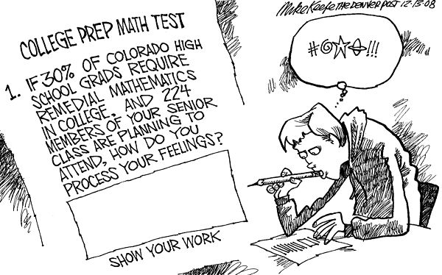
Why study math in a University?
Math can be used to solve real-world problems
Math majors have some of the highest levels of job satisfac-tion
Math provides a solid founda-tion for advanced studies in other fields

Slide 14
Why study math in a University?
Do I have to be a genius to study math?
What A level results do I need?
I don’t have an A level in math – can I still study math at university?
Do I need advanced level math courses taken prior to study math at university?

Slide 15
Why study math in a University?
Do I have to be a genius to study math?
What A level results do I need?
I don’t have an A level in math – can I still study math at university?
Do I need advanced level math courses taken prior to study math at university?

Slide 16
Why study math in a University?
Do I have to be a genius to study math?
What A level results do I need?
I don’t have an A level in math – can I still study math at university?
Do I need advanced level math courses taken prior to study math at university?

Slide 17
Why study math in a University?
Do I have to be a genius to study math?
What A level results do I need?
I don’t have an A level in math – can I still study math at university?
Do I need advanced level math courses taken prior to study math at university?

Slide 18
Careers requiring Math

Slide 19
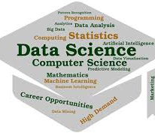
Careers requiring Math
#1. Data Scientist
Average salary: $118,370

Slide 20
Careers requiring Math (cont.)
#2.Software Developer
Average salary: $105,590

Slide 21
Careers requiring Math (cont.)
#3. Economist
Average salary: $104,340

Slide 22
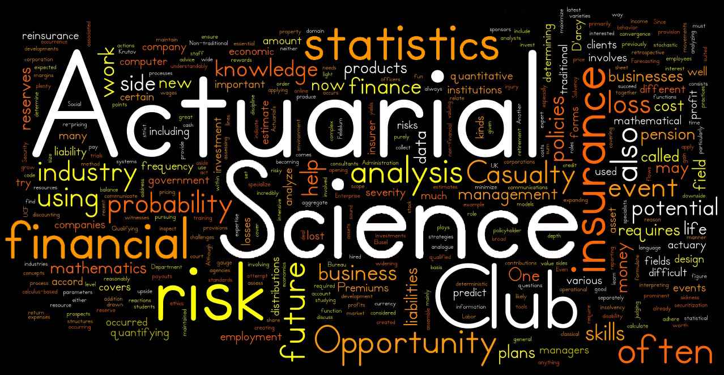
Careers requiring Math (cont.)
#4. Actuary
Average salary: $102,880

Slide 23
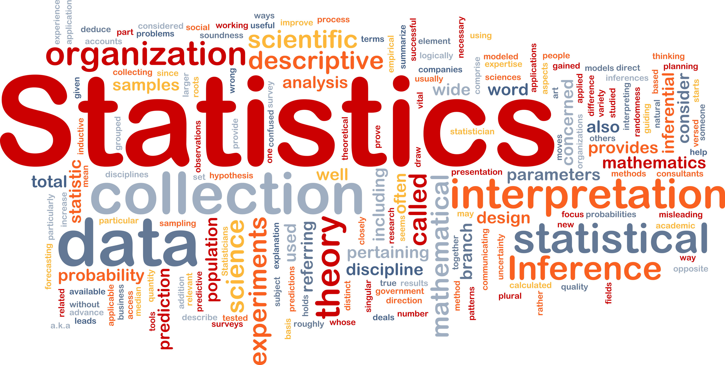
Careers requiring Math (cont.)
#5. Statistician
Average salary: $88,190

Slide 24
Careers requiring Math (cont.)
#6. Financial Analyst
Average salary: $85,660

Slide 25
Careers requiring Math (cont.)
#7. Medical Scientist
Average salary: $84,810

Slide 26
Careers requiring Math (cont.)
#8. Computer Programmer
Average salary: $84,280

Slide 27
Careers requiring Math (cont.)
#9. Data or Research Analyst
Average salary: $83,390

Slide 28
Careers requiring Math (cont.)
#10. Auditor
Average salary: $70,500

Slide 29
Best Jobs 2019
(based on environment, income, outlook, and stress)
#1. Data Scientist (median salary: $114,520)
#2. Statistician (median salary: $84,760)
#3. University Professor (median salary: $84,760)
#4. Occupational Therapist (median salary: $83,200)
#5. Genetic Counselor (median salary: $77,480)
#6. Medical Services Manager (median salary: $98,350)
#7. Information Security Analyst (median salary: $95,510)
#8. Mathematician (median salary: $84,760)
#9. Operations Research Analyst (median salary: $81,390)
#10. Actuary (median salary: $101,560)

Slide 30
Academia
Lab
Industry

Slide 31
MATHEMATICS
Pure Math
Algebra, Geometry, Number Theory, Combinatorics, Logic, Dynamical Systems, etc.
Applied Math
Computational Math, Mathematical Biology, Financial Math, Fluid Mechanics, Statistics, etc.

Slide 32
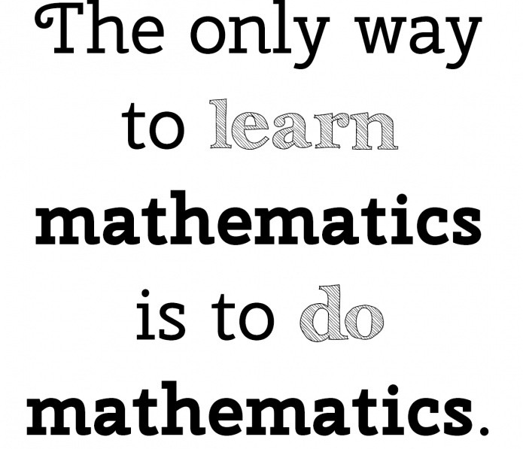
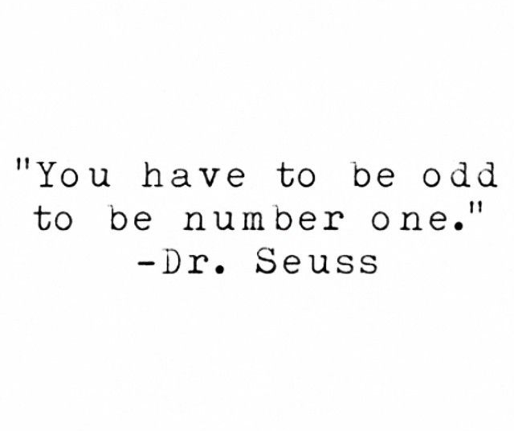
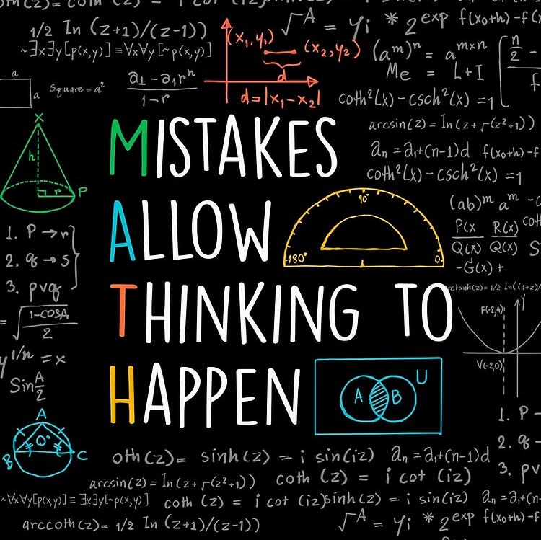
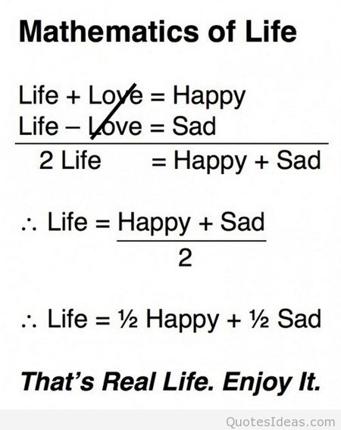
Famous quotes about MATH

Slide 33
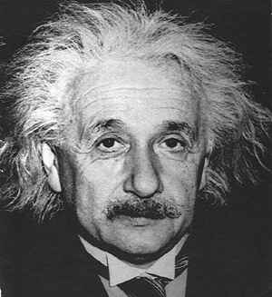
Inspirational Quotes by Albert Einstein
A person who never made a mistake never tried anything new
Everything should be made as simple as possible but not simpler
Education is not the learning of facts but training of the mind to think
Ego=1/Knowledge, hence, More the Knowledge Lesser the Ego, and Lesser the Knowledge More the Ego…
If you can’t explain it simpler, you don’t understand it well enough
Genius is 1% of Talent and 99% Hard Work
Education is what remains after one has forgotten what one has learnt in school
Only two things are infinite, the universe and human stupidity, and I’m not sure about the former

Slide 34
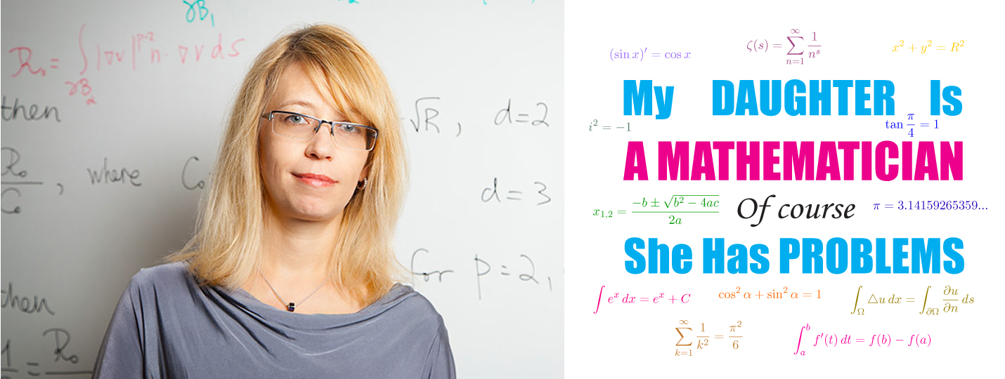
Thanks a lot for your attention!
Questions?
Image Credits: thanks to numerous Internet resources via Goolge search!

